Slide 1
19Z603-DISTRIBUTED COMPUTING

Slide 2
SYLLABUS
INTRODUCTION, MESSAGE PASSING AND RPC : Definition - System models - Design issues of distributed operating systems - Message Passing: Features and Issues–Buffering - Process addressing - Failure handling RPC: Model - Implementation - Stub generation - RPC Messages - Marshaling - Server management – Call semantics (10)
SYNCHRONIZATION : Clock synchronization - Physical clocks - Logical clocks - Election algorithms – Mutual exclusion- Deadlocks (8)
PROCESS AND RESOURCE MANAGEMENT: Process migration: Features - Mechanism. Resource Management: Load balancing approach - Load sharing approach (9)
CLOUD AS A DISTRIBUTED ENVIRONMENT : The Vision of Cloud Computing - Defining a Cloud - Historical Developments -Cloud Computing Reference Model –Cloud Deployment Models - Public, Private, Community, Hybrid Clouds - Cloud Delivery Models - IaaS, PaaS, SaaS - Characteristics and Benefits - Challenges. (8)
CLOUD TECHNOLOGIES : Technologies for Infrastructure as a service - Platform as a Service– Software as a service – Cloud Storage: MapReduce, GFS, HDFS - Cloud container: Docker. (10)
‹#›

Slide 3
TEXT BOOKS AND REFERENCES
TEXT BOOKS:
1. Pradeep K Sinha , "Distributed Operating Systems: Concepts and Design", Prentice Hall of India, New Delhi, 2009.
2. Rajkumar Buyya, Christian Vecchiola, Thamarai Selvi S , "Mastering Cloud Computing", Tata McGraw Hill Education Private Limited,, New Delhi, 2013.
REFERENCES:
1. Andrew S Tanenbaum, Marteen Van Steen , "Distributed Systems Principles and Paradigms", Pearson Education / Prentice Hall of India, New Delhi, 2007.
2. George Coulouris, Jean Dollimore , "Distributed Systems Concept and Design", Pearson Education, New Delhi, 2006.
3. David S Linthicium , "Cloud Computing and SOA Convergence in your Enterprise", Pearson, USA, 2010.
4. Sébastien Goasguen , "Docker in the Cloud -Recipes for AWS, Azure, Google, and More", O‘Reilly Media, USA, 2016.
‹#›

Slide 4
COURSE OUTCOMES
CO1: Depict the issues, models of distributed systems and Describe message passing and develop RPC based client-server programs
CO2:Analyze and apply synchronization, deadlock management techniques
CO3:Paraphrase, apply process management and resource management in distributed systems
CO4:Understand the concepts, key technologies and strengths of cloud computing
CO5: Explore different cloud programming tools and technologies and deploy cloud based application

Slide 5
Computer Architecture
Multiprocessors
Tightly Coupled Systems(Parallel Processing Systems)
Single System Memory Shared by all Processors
Small and limited bandwidth
CPU
CPU
CPU
MEMORY
INTERCONNECTION HARDWARE
‹#›

Slide 6
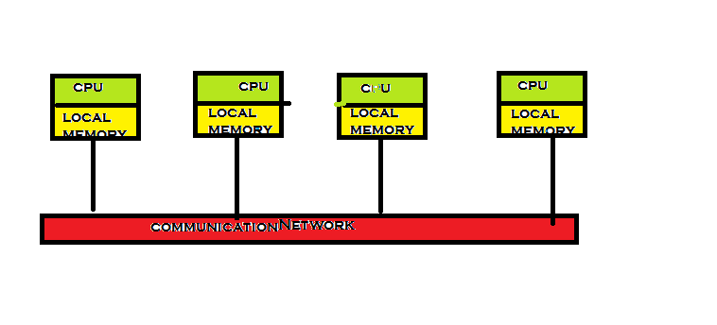
Computer Architecture
2. Loosely Coupled Systems(Distributed Computing Systems)
Processors have their own local memory
and communicate between them
Expandable and Unlimited no of processor
‹#›

Slide 7
Distributed Computing System
A distributed computing system is a collection of processors connected by a communication network, where each processor has its own local memory and other peripherals. Communication between any two processors in the system occurs through message passing over the communication network.

Slide 8

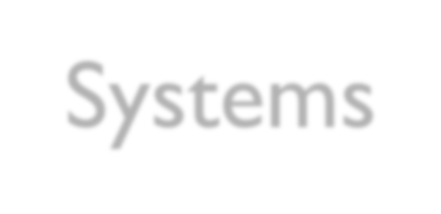
Evolution of Distributed Computing Systems
Early Computers
Job SetUp Time
Batch Processing
Multiprogramming
Multiple user can access
Time Sharing (resource share and access from different place)
Mini Computers
Workstation
MicroProcessors
LANs/WANs
Merging of Computers and Networking-
🡪Distributed Computing Systems(1970s)
‹#›

Slide 9
Distributed Computing System Models
Distributed Computing Systems
Mini Computer
Work Station
Work Station-Server Processor Pool
Hybrid
‹#›

Slide 10

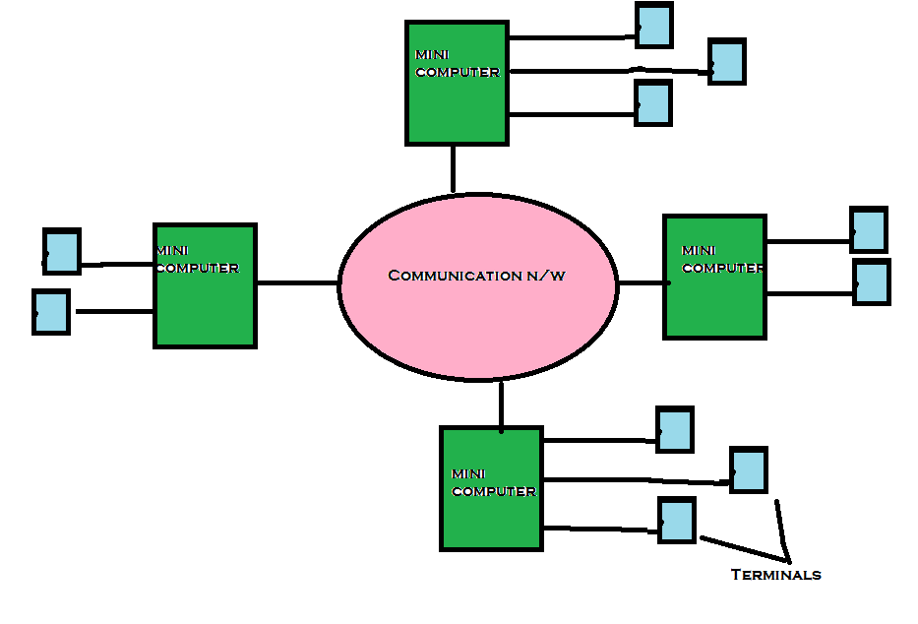
Mini Computer Model
‹#›

Slide 11

Mini Computer Model
Different databases on different remote machines
Extension of time sharing systems
Multiple users simultaneous login
Example ARPANET
‹#›

Slide 12

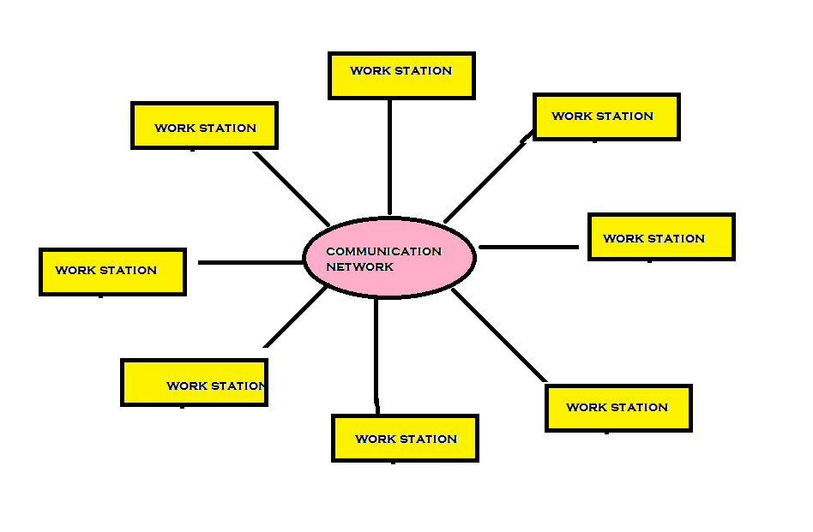
Work Station Model
‹#›

Slide 13

Work Station Model
 Idle workstation in big campus
Issues
Finding idle ws
How to transfer job
Suppose if it starts working?
Allow remote process to share the resources of the workstation along with its own logged on users processes.
Kill the remote process
Migrate remote process back to its home workstation
‹#›

Slide 14

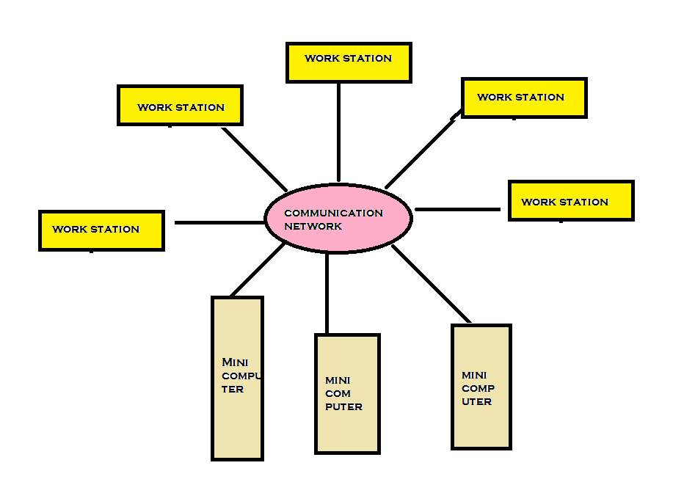
Work Station Server Model
‹#›

Slide 15
Work-Station Server Model
- Consists of few minicomputers and several workstations interconnected by a communication network.
Diskful workstations-Work station model is a Network of personal workstations, each with its own disk and a local file system
Diskless workstations
Cheaper-few minicomputers equipped with large, fast disks that are accessed over the network
Diskless Workstation are preferred-Backup and H/W maintenance are easier
No process migration needed
Request Response protocol is used to access the services of the server machines
‹#›

Slide 16

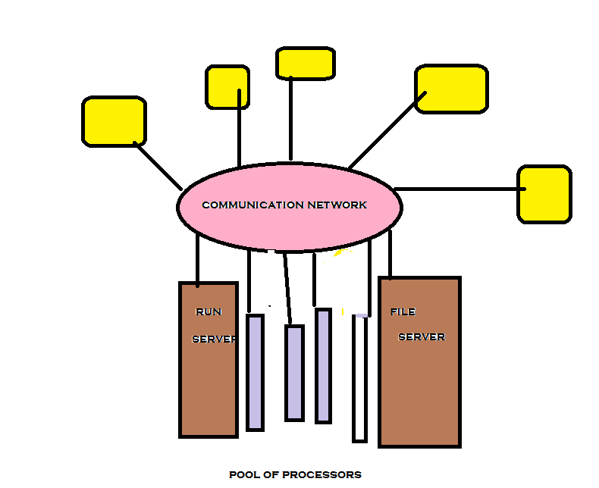
Processor Pool Model
Terminals
‹#›

Slide 17
Processor Pool Model
Most of the time user does not need computing power but once in a while user needs a very large amount of computing power for a short time.
In workstation server model, processor is allocated to each user but in Processor poor model Processors are gathered-Users share whenever needed
Terminals are diskless workstations
Run Server- Special server manages and allocated the processors in the pool to different users on a demand basis
‹#›

Slide 18
Processor Pool Model
As compared to workstation -server model , Processor Pool Model
Allows Better utilization of processors
Provides Greater Flexibility- System services can be easily expanded without the need to install any more computers
Considered to be unsuitable for high performance interactive applications –especially those using graphics or window systems
- due to slow speed of communication between the computer on which the application program is executed and the terminal via which the user is interacting
‹#›

Slide 19

Hybrid Model
Out of the four models WS-Server model is widely used for building distributed computing systems Because Suitable for interactive jobs
Processor-pool model is suitable for Massive applications which need computations
Hybrid model is based on the WS-Server model but with the addition of a pool of processors
Processors in the pool can be allocated dynamically for computations that are too large for workstations
‹#›

Slide 20



Hybrid Model
Ws-server model
Processor pool model
Hybrid model
‹#›

Slide 21

What is a Distributed OS?
os
Network OS
Distributed OS
‹#›

Slide 22

Differences
A network operating system is made up of software and associated protocols that allow a set of computer network to be used together.
A distributed operating system is an ordinary centralized operating system but runs on multiple independent CPUs.
Metrics | Network OS | Distributed OS
System Image | The Users are aware that multiple systems are used | Virtual Uniprocessor
 | The User knows in which machine his job is executed | Unaware of this information
 | User know where his/her information is stored | Does not know
 | Explicit commands for file transfer | Same Commands
 | Control over file placement is manual | Automatic
‹#›

Slide 23
Differences
Metrics | Network OS | Distributed OS
Autonomy | Each Computer is independent | Not independent
 | Have local OS | Common OS
 | Degree of autonomy is high | Low
Fault Tolerance Capability | Little or No fault tolerance capability | High Fault tolerance
Example | Microsoft Windows Server 2003, Microsoft Windows Server 2008, UNIX, Linux | AIX operating system for IBM RS/6000 computers. Solaris operating system for SUN multiprocessor workstations. .
‹#›

Slide 24
ISSUES IN DESIGNING
DISTRIBUTED OS
Differences in the complexity of the Design between traditional system and Distributed system
Centralized Os-User can request status information and it is available
Distributed OS- cannot have Complete information
about the system and not available to the user.
Centralized Os- Resources are nearer Distributed Os-Far away
Centralized Os- Common Clock
Distributed OS- No Common clock,Lack of Up to date information (Delivery of messages – delayed/lost)
‹#›

Slide 25
ISSUES
Transparency
Reliability
Flexibility
Performance
Scalability
Heterogeneity
Security
‹#›

Slide 26


A lot of issues But
flexible,
efficient,
reliable,
secure, and
easy to use.
‹#›

Slide 27
Transparency
Single Virtual Uniprocessor image
Eight forms of transparency - ISO 1992 Reference Model for Open Distributed Processing
Access transparency
Location transparency,
Replication transparency,
Failure transparency,
Migration transparency
Concurrency transparency,
Performance transparency, and
Scaling transparency
‹#›

Slide 28

Transparency
Access transparency
User should not be able to recognize a resource as local or remote
Remote resources in the same way as local
Uniform system calls
Suitable for limited types of application due to its Performance limitations
‹#›

Slide 29
Name Transparency
Transparency
Location Transparency
User Mobility
‹#›

Slide 30
Transparency
Name Transparency
Name of resource does not reveal physical location of the resource
Movement of files need not change the names
Resource names are unique
User Mobility
Same resources from different locations are accessed with same name.
Users access to resources without any extra effort
‹#›

Slide 31
Replication Transparency
Transparency
Creating Replicas of files and resources on different nodes of distributed systems –Better performance and reliability
Should be transparent to users
Issues
Naming of replicas (name of replica should be mapped to user supplied name by the system)
Replication control (No.of copies? When to create? Where to place?)
‹#›

Slide 32
Failure Transparency
Masking from users- partial failure in the system
DOS will continue to function in degraded form when failure occurs.
communication link failure,
a machine failure, or
storage device crash
All types of failures cannot be handled in a user transparent manner.
Theoretically possible, Practically not justified
‹#›

Slide 33
Transparency
Migration Transparency –
(Performance ,Reliability, Security)
Migration decisions should be automatic
Migration should not require any change in name
If the receiver process migrates to another location before receiving messages from the sender , IPC should ensure that migrated process receives the message.
Concurrency Tranparency
Multiple user- spatially separated use the system concurrently
Concurrent update of the same file by two processes should not be allowed
‹#›

Slide 34
Event Ordering Property
Access request to resources -> properly ordered
Concurrency Resource sharing mechanism
No Deadlock Property
No Starvation Property
Mutual Exclusion Property
‹#›

Slide 35
Transparency
Performance Transparency
To allow the system to be automatically reconfigured
Processor – Loads should be distributed(No Idle Processors)
Processing capability should be uniformly distributed among the available jobs
Requirement
Intelligent resource allocation and migration facility
Scaling Transparency
To allow system to expand without disturbing the user activities.
Requirement
Use of Open System Architecture
Use of scalable algorithms
‹#›

Slide 36
2.Reliability
DS expected to be more reliable – Due to Multiple instances of resources
Reliability
Fault-Mechanical or algorithmic defect that may generate an error.
Fault Avoidance
Fault Tolerance
Fault Detection/Recovery
Fault->Failure
‹#›

Slide 37
Reliability
System Failure
Fail-stop –System stop functioning after changing to the state in which failure can be detected
Byzantine –System continues to function but produces wrong result.
System bugs causes this failure.

Slide 38
Reliability
1. Fault Avoidance
Designing the components to minimize the occurrence of faults
Use high reliability components
The Designers of software components has to test to make the hardware components highly reliable .
2.Fault Tolerance
Ability of the system to function in the event of partial system failure
Techniques to improve fault tolerance
i. Redundancy Techniques
To avoid single point of failure -Hardware and software components are replicated.
Additional system overhead is needed to maintain replicas to ensure that they are consistent.
‹#›

Slide 39

Reliability
How much replication is enough?
System is said to be k-fault tolerant if it can continue to function even in the event of the failure of k components.
K fail stop failures – k+1 replicas
K byzantine failure - min 2k+1 replicas (voting mechanism)
ii. Distributed Control
Distributed control mechanism is used in name servers, scheduling algo to avoid single points of failure.
‹#›

Slide 40
3.Fault Detection and Recovery
Use of H/W and S/W mechanism to determine the occurrence of failure and then to correct system to an acceptable state.
Techniques:
i. Atomic Transactions
Collection of operations that takes place indivisibly in presence of failure
All operations goes to completion or none- incase of failure data object restore to original state if system supports trans mechanism

Slide 41
Client - server
Reliability
ii. Stateless Servers
Stateful
Stateless
‹#›

Slide 42
Stateful Server: Depends on history of serviced request.
Stateless Server – Crash Recovery- Easy- No client state info is maintained.

Slide 43
Reliability
iii. Acknowledgements and time-outs based retransmissions
Node crash/Communication link failure-message lost
Duplicate messages are a problem here
Detection and handling of Duplicate messages
- Generating and assigning Sequence Numbers to messages
‹#›

Slide 44


3.Flexibility
 Why DOS should be flexible?
Ease of modification - Some parts of design needs to be replaced/modified if bugs detected or not suitable for changed system
Ease of enhancement –User should have the flexibility to add new service or the change the existing style.
The important design factor is Designing the kernel of the OS
Monolithic Kernel
Kernel
Micro Kernel
‹#›

Slide 45
Flexibility
Kernel of an OS is its central controlling part that provides basic system facilities with separate address space inaccessible to user processes. User cant replace or modify
Monolithic Kernel
All functions are provided by the kernel
Big structure
UNIX
Micro Kernel
To Keep Kernel as small as possible
OS provides minimum facilities - Services provided is IPC -Low Device mgmt and Mem. Management
other services are implemented as user level server processes.
‹#›

Slide 46
Flexibility
Node1
Node 2
Node n
User Applications |  | User Applications |  | User Applications
Monolithic Kernel |  | Monolithic Kernel |  | Monolithic Kernel
 |  | Network Hardware
MONOLITHIC KERNEL
‹#›

Slide 47




Microkernel
Node 1
Node 2
Node n
User Applications
User Applications
User Applications
Server / Manager
Modules
Server / Manager
Modules
Server / Manager
Modules
Microkernel
Microkernel
Microkernel
Network Hardware
‹#›

Slide 48

Flexibility
Monolithic Model | Microkernel Model
Major OS services are provided by the kernel | Only minimal facilities and services are provided
Kernel has a large monolithic structure | Size of the kernel is small
No such thing | User level server processes services
Large size reduces flexibility | Increased flexibility
Reduced Configurability | Highly modular in nature
complex | Easy to modify
complex | Easy to add services
Changes can be done by interrupting users | Without interrupting users, the changes can be performed In the OS
No | the servers have to use some form of message-based interprocess communication mechanism
No | Message passing requires context switches
 | 54

Slide 49
Performance
Design principles in order to achieve Good Performance are
1. Batch if possible
Large chunks of data- transfer instead of small across network
Piggybacking acknowledgement (Message Exchange)
2. Cache whenever possible
Makes data available
Saving large amount of Computing time and bandwidth
3.Minimize copying data
 Data path to send the message
Senders Stack to Message buffer
Message buffer in sender address space to message buffer in kernel address space
From kernel to Network Interface Board
Receiving Same in reverse
‹#›

Slide 50

Performance
4. Minimize network traffic.
migrating a process closer to the resources
to cluster two or more processes that frequently communicate with each other on the same node of the system
5. Take advantage of fine-grain parallelism for multiprocessing
Threads-used for structuring the server processes- Simultaneously service requests from clients
concurrency control of simultaneous accesses by multiple processes to a shared resource
‹#›

Slide 51
Scalability
capability of a system to adapt to increased service load.
PRINCIPLES FOR DESIGNING SCALABLE SYSTEMS
1. Avoiding centralized entities (such as single file server or single database)
The failure of the centralized entity often brings the entire system down. Hence, the system cannot tolerate faults
Even if the centralized entity has enough processing and storage capacity, the capacity of the network saturated
In a wide-area network consisting several interconnected LAN increases network traffic.
The increased users increases the complexity
‹#›

Slide 52
Scalability
2. Avoid centralized algorithms.
This algorithm collects information from all nodes.
Processing info on single node and distributing the results to rest of the nodes- Not acceptable from a scalable point of view.
Eg: Scheduling algo – selects lightly loaded node -host selection time too long.
 The complexity of the algorithm is O(n2)
It creates heavy network traffic and quickly
consumes network bandwidth.Therefore, in the design of a distributed operating system, only decentralized algorithms should be used.
 3. Perform Most operations on a client workstations - Caching
‹#›

Slide 53
Heterogeneity
Interconnected set of dissimilar hardware and software
Incompatibilities in heterogeneous DS:
Communication protocols
Topologies
Servers operating at different node of system may be different.
Pros
-Provides Flexibility – Different computer platforms for different applications.
‹#›

Slide 54
Heterogeneity
We need translator which converts each format in the system to the format used in receiving node.
n formats – (n-1) pieces of translation software at each node – n(n-1) pieces of translation software in the system.
Complex
Intermediate standard data format -Less no. of conversions

Slide 55

Security
In a centralized system, all users are authenticated by the system at login time.
- system can easily check whether a user is authorized to perform the requested operation on an accessed resource.
In a distributed system this is not possible.
So Design should include to know
Sender of the message should know that the message was received by the intended receiver
Message sent by a genuine sender
The content of the message is not altered
Cryptography and integrity(Trusting smaller servers rather than clients)
‹#›

